Slide 1


Low-cost Laboratory Environment Monitoring and Alert System
Michael Braine
Dimensional Metrology Group
NCSLi @ Portland, OR
29 August 2018
www.nist.gov/pml/engineering-physics-division/dimensional-metrology
Dimensional Metrology Group
Engineering Physics Division
Physical Measurement Laboratory
Notes:
Good afternoon, I am Michael Braine from the Dimensional Metrology Group at NIST and you are here to learn, hopefully, a bit about an inexpensive open-source laboratory environment monitoring system developed at and used by NIST.

Slide 2
Overview
Purpose?
ISO 17025
Temperature and humidity in Dimensional Metrology
Design and cost
Example data
Lab environment incidents
Monitoring website
Link to Github download
www.nist.gov/pml/engineering-physics-division/dimensional-metrology
Dimensional Metrology Group
Engineering Physics Division
Physical Measurement Laboratory
Notes:
We have just a few things to go over before getting to the design and sharing of the software.

Slide 3
Overview
Purpose?
ISO 17025
Temperature and humidity in Dimensional Metrology
Design and cost
Example data
Lab environment incidents
Monitoring website
Link to Github download
www.nist.gov/pml/engineering-physics-division/dimensional-metrology
Dimensional Metrology Group
Engineering Physics Division
Physical Measurement Laboratory
Notes:
I wanted to start with discussing the reasoning for wanting to build something like this ourselves instead of using a commercial product.

Slide 4
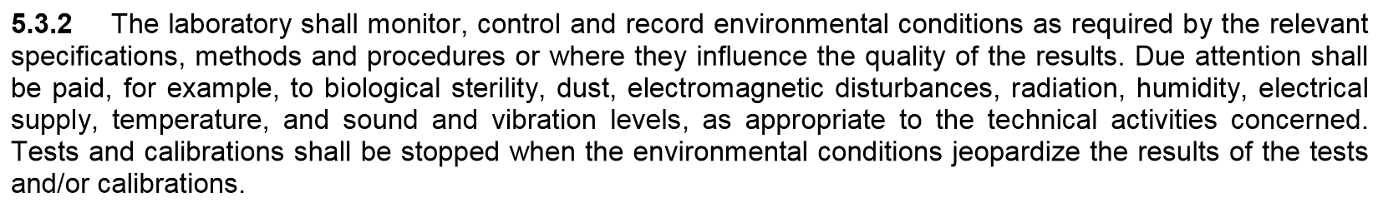
Purpose?
From ISO 17025:2005, sec 5.3.2:
www.nist.gov/pml/engineering-physics-division/dimensional-metrology
Dimensional Metrology Group
Engineering Physics Division
Physical Measurement Laboratory
Notes:
First, ISO 17025 says you must maintain a record of your environment that affects measurements. In our labs we have traditionally done this through a rotary chart recorder or with the various sensors that help our labs maintain our desired environment, but unless you knew how to access the data from the HVAC system, it was somewhat impractical for the average user and cumbersome during audits. Because these sensors are used to maintain our lab’s environment, they are non-networked.
Secondly, and lets be honest, most staff will only access the data when required, no one will readily go out of their way to check the system for whether the labs have been behaving recently until they attempt to make a measurement, see that it fails, or see the environment is outside of their requirements. In this case, the lab could have been out of specification for hours or even days if after a weekend. In dimensional metrology, a weekend outage can be detrimental to your workload because a lot of us use large heavy granite slabs that will absorb a lot of heat and take a very long time to return to equilibrium, well after the environment in the room has returned.

Slide 5
Purpose?
Dimensional Metrology Group
Identified need to be informed of unexpected outages
Large volume CMMs with low uncertainties (M48s), instrumentation sensitive to environment changes
Downtime of up to 4 days from lab temperature changes
Lab failure can raise temperature to up to 30 deg. C
Lab failure can cause water to condense
Commercial systems
Fairly expensive
Many, if not all, hosted data offsite (BIG no-no for NIST IT Security)
www.nist.gov/pml/engineering-physics-division/dimensional-metrology
Dimensional Metrology Group
Engineering Physics Division
Physical Measurement Laboratory
Notes:
In our group, for the M48 CMMs, John Stoup has uncertainties in the tens of nanometers over 1.2 meters on his longest measurement axis. After a short outage of half a degree Celsius for 5 or 10 minutes, this will set him back at least several hours, more if during a measurement program. Depending on how much heat a steel artifact absorbs in those 10 minutes, a 1.2 meter steel artifact could increase in length up to 7 micrometers. The error will be magnified depending on the amount of structural bending from thermal induced stresses in the CMM. During a maintenance outage where the temperature can spike to 25 to 30 degrees C for the majority of the weekend, the M48 CMMs are down for 3 to 4 days. If the humidity increases, then the issue of risk of water damage to priceless instrumentation or customer artifacts is raised if water condenses on surfaces. There have been times when HVAC controls have unexpectedly failed so a lab at 25 to 30 degrees C is not isolated to these maintenance outages.

Slide 6
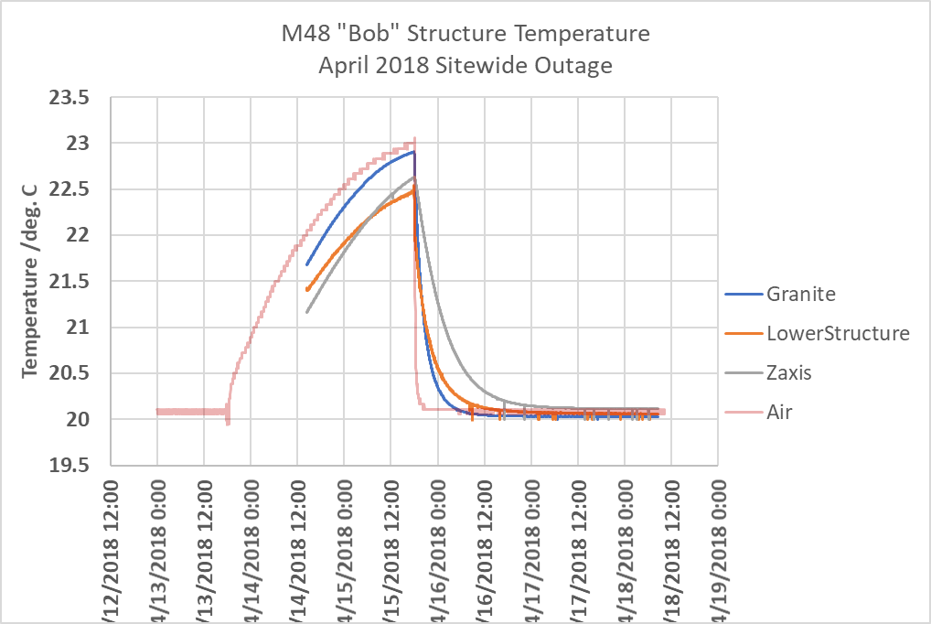
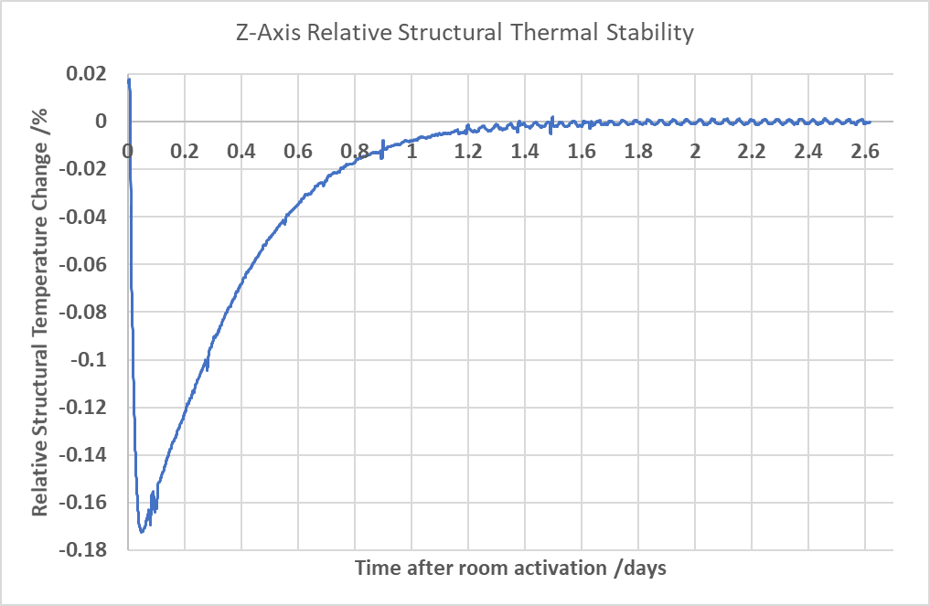
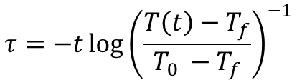
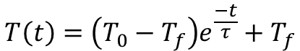
Purpose?
$$T\left(t\right)=\left(T_{0}−T_{f}\right)e^{\frac{−t}{τ}}+T_{f}$$
$$τ=−t\log{{\left(\frac{T\left(t\right)−T_{f}}{T_{0} −T_{f}}\right)}^{−1}}$$
www.nist.gov/pml/engineering-physics-division/dimensional-metrology
Dimensional Metrology Group
Engineering Physics Division
Physical Measurement Laboratory
Notes:
Something that I have been curious about is when there are planned sitewide maintenance outages for the lab steam and cold water supplies twice per year, how hot does a CMM really get, and how long does it take to recover? For the past sitewide outage in April, we placed several sensors in key locations throughout one of our M48’s structure to estimate the structural temperature. We found it took approximately 2-2.5 days for the z-axis to stop measurably changing temperature, shown on the right by examining how the z-axis temperature was changing. In the AML building, treated air enters the room from the ceiling and leaves at the edges of the floor, so the z-axis arm is mostly shielded from the airflow. The air temperature only reached 23 degrees C, but I have seen upwards of 30 degrees C. Since this experiment was an approximation of the instrument’s core temperature, it is in our interests to add a safety factor to ensure temperatures in the core of the instrument have also stabilized and the structure is not bending, hence allowing at least 3-4 days for our CMMs to settle. I don’t have a picture of the CMMs, but they are very massive cast iron monolithic structures.
From this data, you could determine a time-constant using an exponential decay model that will help describe how long the instrument takes to return to temperature, given an initial temperature and the temperature of the air, but we want to minimize the amount of time it takes for instrumentation to return to equilibrium, be more actively informed of our environment, and mitigate the potential risk of damaged equipment.

Slide 7
Purpose?
Dimensional Metrology Group
Identified need to be informed of weekend outages
Large volume CMMs with low uncertainties (M48s), instrumentation sensitive to environment changes
Commercial systems
Fairly expensive
Many, if not all, hosted data offsite (BIG no-no for NIST IT Security)
www.nist.gov/pml/engineering-physics-division/dimensional-metrology
Dimensional Metrology Group
Engineering Physics Division
Physical Measurement Laboratory
Notes:
So, what if we knew exactly when a lab goes out of specification and take a proactive approach to fixing the lab so that the environment can come back sooner and lose only hours instead of days? Therefore, we wanted a system that monitors the environment and raises alerts under various conditions.
We found most if not all commercial products that have the desired monitoring and messaging capabilities require the data to be hosted offsite, which was a huge no-no for NIST IT security. Many of these systems are fairly expensive, and with nearly 30 labs, it would be an enormous expense for our group. So we looked into building a system that the user would have total control over, and found it to be relatively inexpensive in both time and capital. The Python programming language includes in its base easy-to-use libraries for sending text messages and emails and Python has a large scientific community, everyone here should know Python. If you take away anything from here, learn to read and write Python programs.

Slide 8
Overview
Purpose?
ISO 17025
Temperature and humidity in Dimensional Metrology
Design and cost
Example data
Lab environment incidents
Monitoring website
Link to Github download
www.nist.gov/pml/engineering-physics-division/dimensional-metrology
Dimensional Metrology Group
Engineering Physics Division
Physical Measurement Laboratory
Notes:
Now we have a desire to be more informed of our environment. How does one build a system when provided the software?

Slide 9
Design and cost
Open Source Design
Raspberry Pi 3 Model B using Raspbian (Debian-based Linux)
5 inch 800x480 display (optional)
Commercial sensor, need serial communications or can read through RPi GPIO pins
Traceable calibration, of course
Python 3 language – many, many scientific packages to expand capability
Data stored by month-year locally on Raspberry Pi 3
Library to send email and text messages
www.nist.gov/pml/engineering-physics-division/dimensional-metrology
Dimensional Metrology Group
Engineering Physics Division
Physical Measurement Laboratory
Notes:
I personally believe heavily in open-source so that is the approach we took, and so that we could share the resulting system, potentially get input, and expand it.
For the hardware: the backbone of the system is just a Raspberry Pi 3 Model B that runs a Debian-based Linux OS called Raspbian. We chose this platform because we needed something with a low heat signature and a small footprint to minimize the effect of its presence in the lab. Many of our labs are extraordinarily sensitive. The Raspberry Pi platform also provides limitless expansion if we ever want to integrate other lab devices to our system. We added a 5 inch display to put the most recent environment in clear view of anyone in the room, but the system can be run without a display to minimize heat input. Finally, we needed a means to gather temperature and humidity. We purchased a commercially available sensor with a thermistor and hygrometer that had RS-232 capabilities and which of course came with a traceable calibration. The entire software makes use of popular Python libraries available in nearly every repository. Using serial communications, we capture the environment and store it locally on the raspberry pi. At the beginning of each month, a new file is automatically created where data for that month is stored.
Taking this system one step further, we also built an internal website that collects recent data from each device every 5 minutes, processes the data, and publishes interactive graphs with statistics for each building and lab. We’ll talk a little bit about this setup later that I call the master system.

Slide 10
Design and cost
Raspberry Pi 3 $35
Display (optional) $60
Cables $30
3D printable case (mat’l only) $5
Commercial sensor $300
Sensor cost is variable, this was the cost of ours
Total without sensor = $130/lab
Total with sensor = $430/lab
www.nist.gov/pml/engineering-physics-division/dimensional-metrology
Dimensional Metrology Group
Engineering Physics Division
Physical Measurement Laboratory
Notes:
The total cost for a single device is very little for each lab. Without the sensor, assuming you can interface into existing environment sensors, the system costs $130 per lab. With the sensor we purchased, $430 per lab. I don’t list the sensor we bought, because NIST cannot appear to endorse any particular company and therein arises a small problem in sharing a design that simply works, the interface will need set up for whatever sensor is paired with the system. If you are familiar with interfacing, this takes 10 minutes, maybe 30 if new. The raspberry pi platforms are open source, and different manufacturers print the same boards, so we can list it.

Slide 11
Design and cost
Schematic
AC Power In
Temperature/Humidity
Combo sensor
USB to RS-232
Raspberry Pi 3
Model B
HDMI
Display
USB Power
Space for expansion:
USB
GPIO
Bluetooth
Ethernet Out
www.nist.gov/pml/engineering-physics-division/dimensional-metrology
Dimensional Metrology Group
Engineering Physics Division
Physical Measurement Laboratory
Notes:
The overall design of the system is very simple. There are three components: a Rpi for the brain, an optional display, and a commercial combination temperature/humidity sensor so we did not have to build a temperature sensing circuit. There is plenty of room for functionality expansion and modularity with USB, and GPIO on the Rpi.

Slide 12
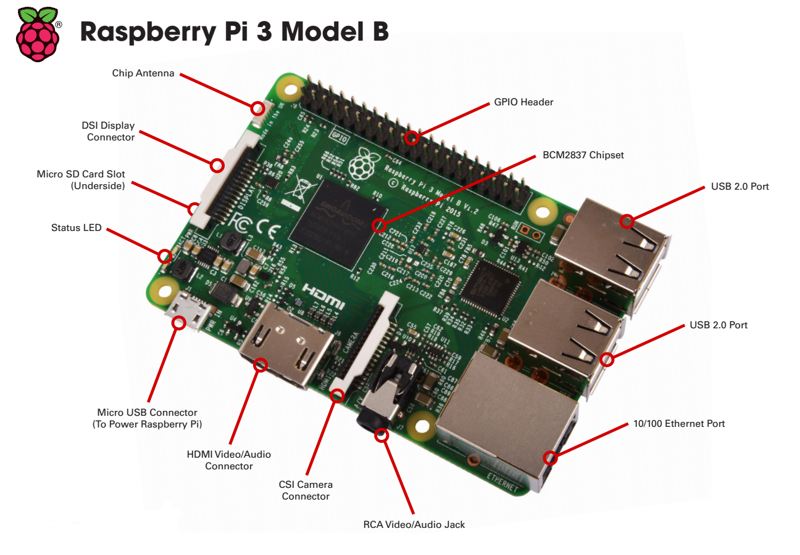
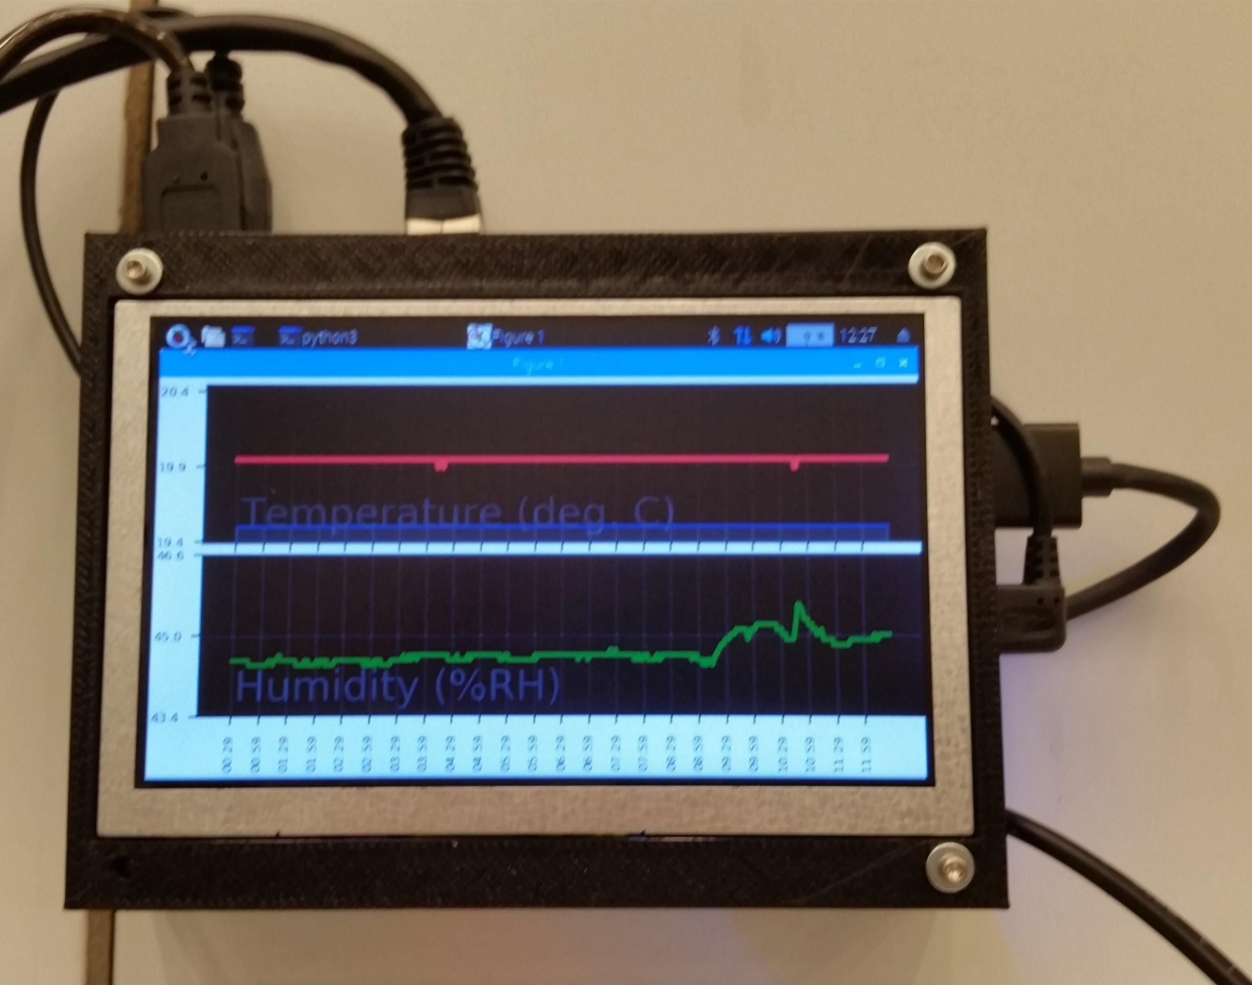
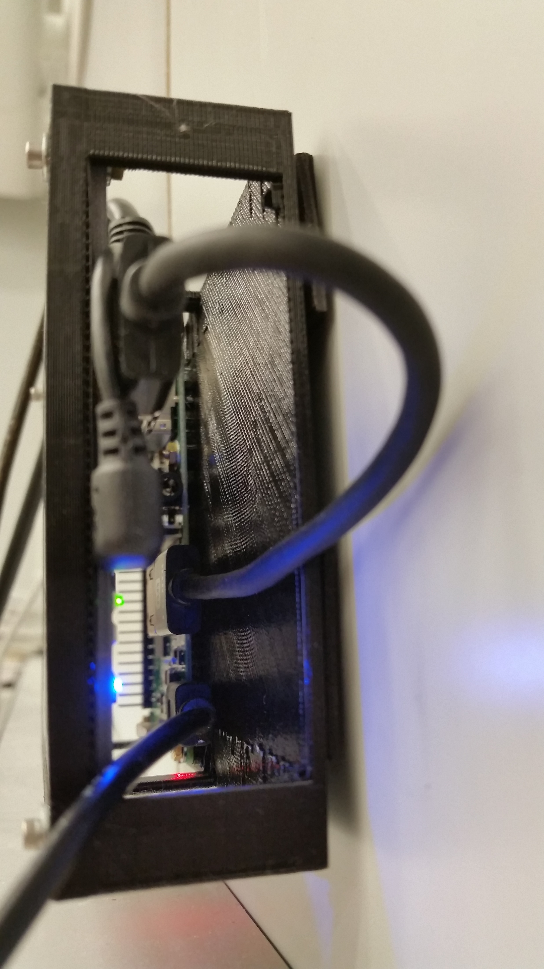
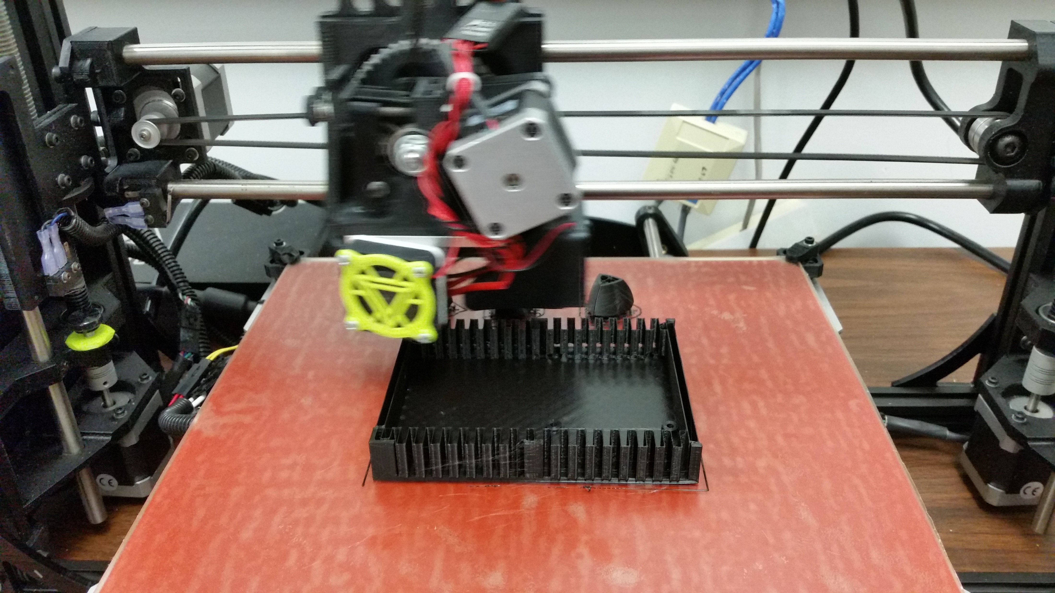
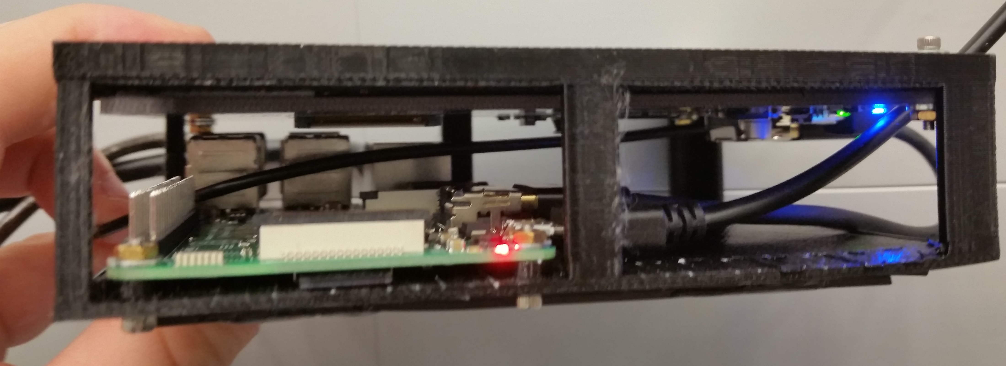
Design and cost
www.nist.gov/pml/engineering-physics-division/dimensional-metrology
Dimensional Metrology Group
Engineering Physics Division
Physical Measurement Laboratory
Notes:
On the left is one of the systems in our labs that is displaying a graph of the environment from the past 12 hours. The top of the graph is temperature and bottom is humidity showing some activity in the past few hours. I also have one with me, and you can see this setup is very small. The Rpi itself is the size of a credit card.
The case is 3D printed ABS plastic. All the walls in our labs are magnetic, so on the back are strips of magnetic tape that hold the device to the lab walls.

Slide 13
Design and cost
.csv data format (comma-separated values) Time, Temperature, Humidity 1, 20.1, 45.0 2, 20.2, 45.0 3, 20.0, 44.9 …, …, …
Easily openable in spreadsheets
Unique user message list for each lab
Unique environment outage settings for each lab
www.nist.gov/pml/engineering-physics-division/dimensional-metrology
Dimensional Metrology Group
Engineering Physics Division
Physical Measurement Laboratory
Notes:
The data is stored in .csv format, or comma-separated values, so that the data can be post-processed by another script, or easily opened in a spreadsheet like Excel.
We came up with a means to have a comprehensive list of users for all devices, with the ability to select which users receive messages from a particular lab by only specifying what lab the device is in. Similarly with the environment outage conditions, there is a comprehensive list of settings but each device only uses its own settings. These configurations are made by only editing their respective text settings files. The idea is, once the comprehensive list of settings for all labs was setup, the only thing that had to change between each lab was specifying in which lab the device was placed.
If you will be running many devices in a large network, as we do, I would recommend having a master system that can trickle user setting changes or updates down to each device over a network and aggregate data in one place. There are very easy to use, single line linux commands to do this, or the PuTTy program on Windows is equivalent. There is a link to an example of a master system at the end of this, the master system that we designed and use.

Slide 14
Design and cost
LabDevice n
LabDevice 1
LabDevice 6
scp/ssh
scp/ssh
scp/ssh
Master
LabDevice 2
scp/ssh
LabDevice 5
scp/ssh
Website
scp/ssh
scp/ssh
Webserver
LabDevice 4
LabDevice 3
www.nist.gov/pml/engineering-physics-division/dimensional-metrology
Dimensional Metrology Group
Engineering Physics Division
Physical Measurement Laboratory
Notes:
If you will be running many devices in a large network, as we do, I would recommend having a master system that can trickle user setting changes or updates down to each device over a network and aggregate data in one place, even host a website to remotely view the environment. There are very easy to use, single line linux commands to transfer data files, or the PuTTy program on Windows is equivalent for scripting. There is a link to an example of the master system that we designed and use at the end of this.

Slide 15
Design and cost
A message is sent from any single device under one of three conditions:
When the set environment has exceeded limits, with a graph
When the set environment has returned within limits for a period of time, with a graph
When the set environment has exceeded limits, and the environment (T or RH) changes in increments of TincSet or RHincSet (LabSettings.py) until the environment returns within limits for a period of time, with a graph
www.nist.gov/pml/engineering-physics-division/dimensional-metrology
Dimensional Metrology Group
Engineering Physics Division
Physical Measurement Laboratory
Notes:
This describes the logic of when a message is sent.
In the first case, the device will send a message with an attached graph to its laboratory owners should temperature or humidity limits be exceeded.
In the second case, the device will send a message with an attached graph to its laboratory owners should temperature or humidity conditions return within limits after a period of consecutive points show it is still within limits.
In the third case, when the environment is outside of the setpoints, the device will send a message for each occasion the environment changes by some increment. E.g., the temperature upper limit is 25 deg. C, and increment setting is 5 deg. C, there will be a message generated at 30 deg. C, 35, deg. C, etc, until the temperature returns below 25 deg. C. This is so that if the environment continues to worsen, the user will be informed.

Slide 16
Overview
Purpose?
ISO 17025
Temperature and humidity in Dimensional Metrology
Design and cost
Example data
Lab environment incidents
Monitoring website
Link to Github download
www.nist.gov/pml/engineering-physics-division/dimensional-metrology
Dimensional Metrology Group
Engineering Physics Division
Physical Measurement Laboratory
Notes:
Next I have some data from the system to share with you. It has been fully active in each of our labs since only March this year, but we have already collected 400 megabytes of environment data from almost 30 labs, totaling somewhere around 10 million points in 6 months.

Slide 17
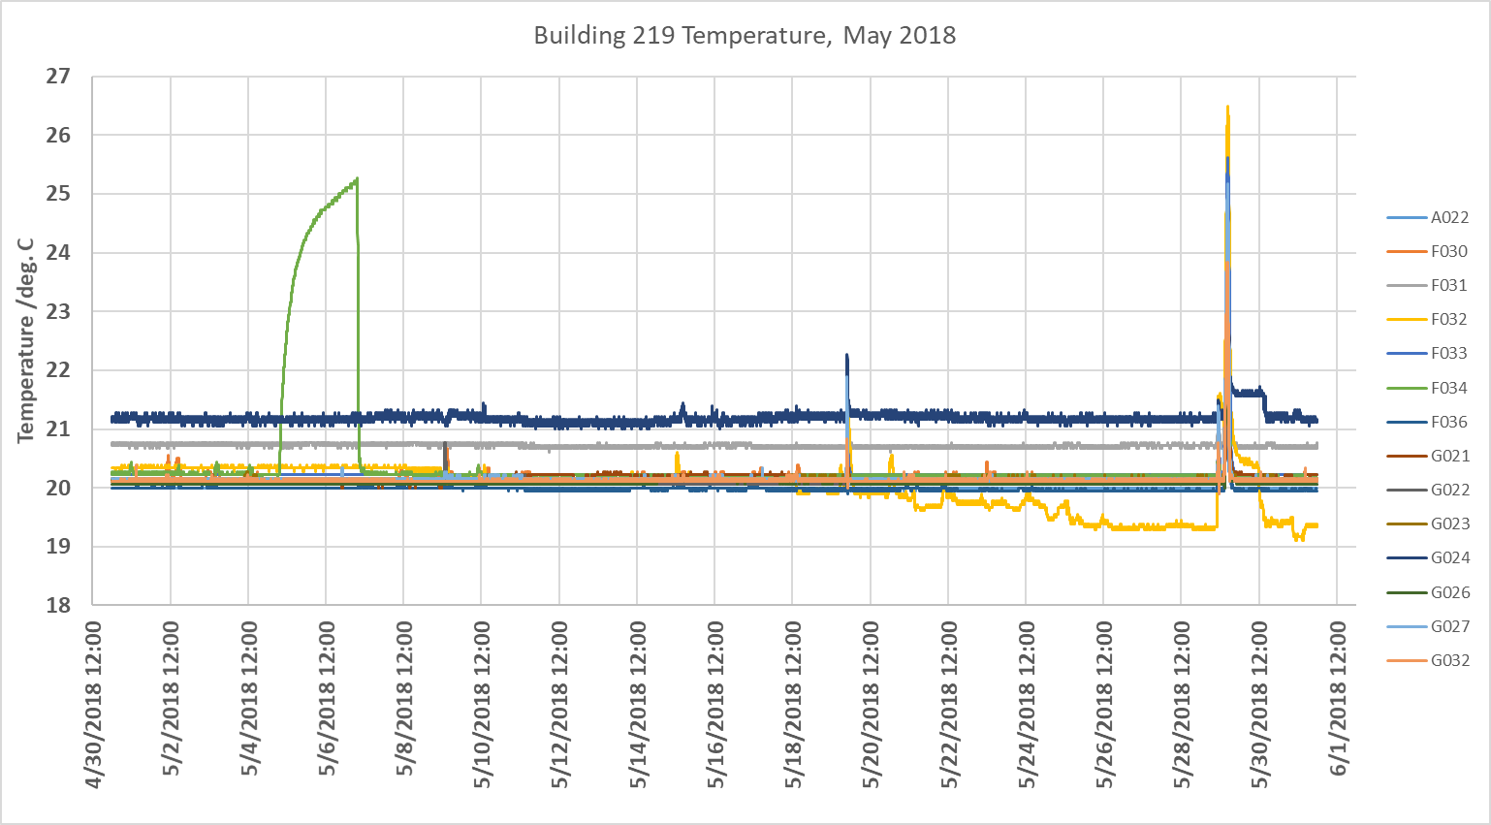
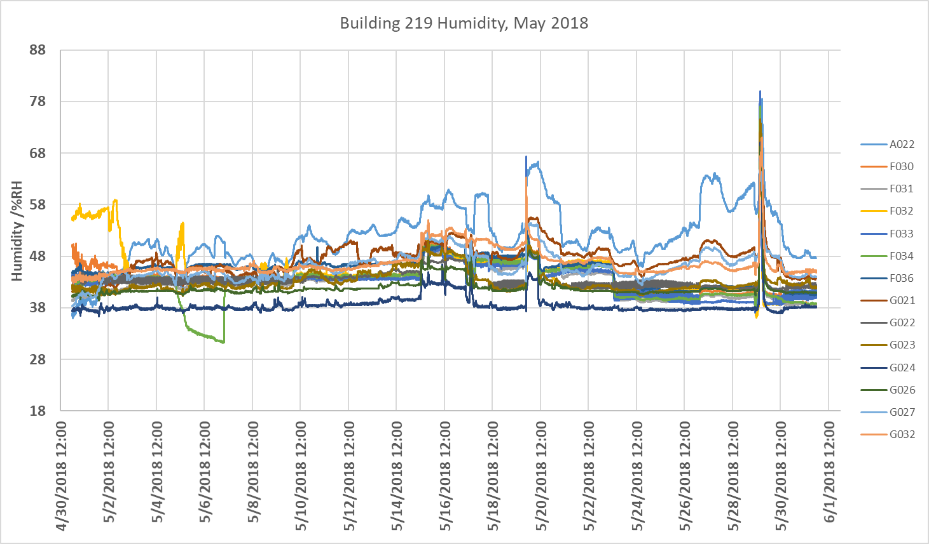
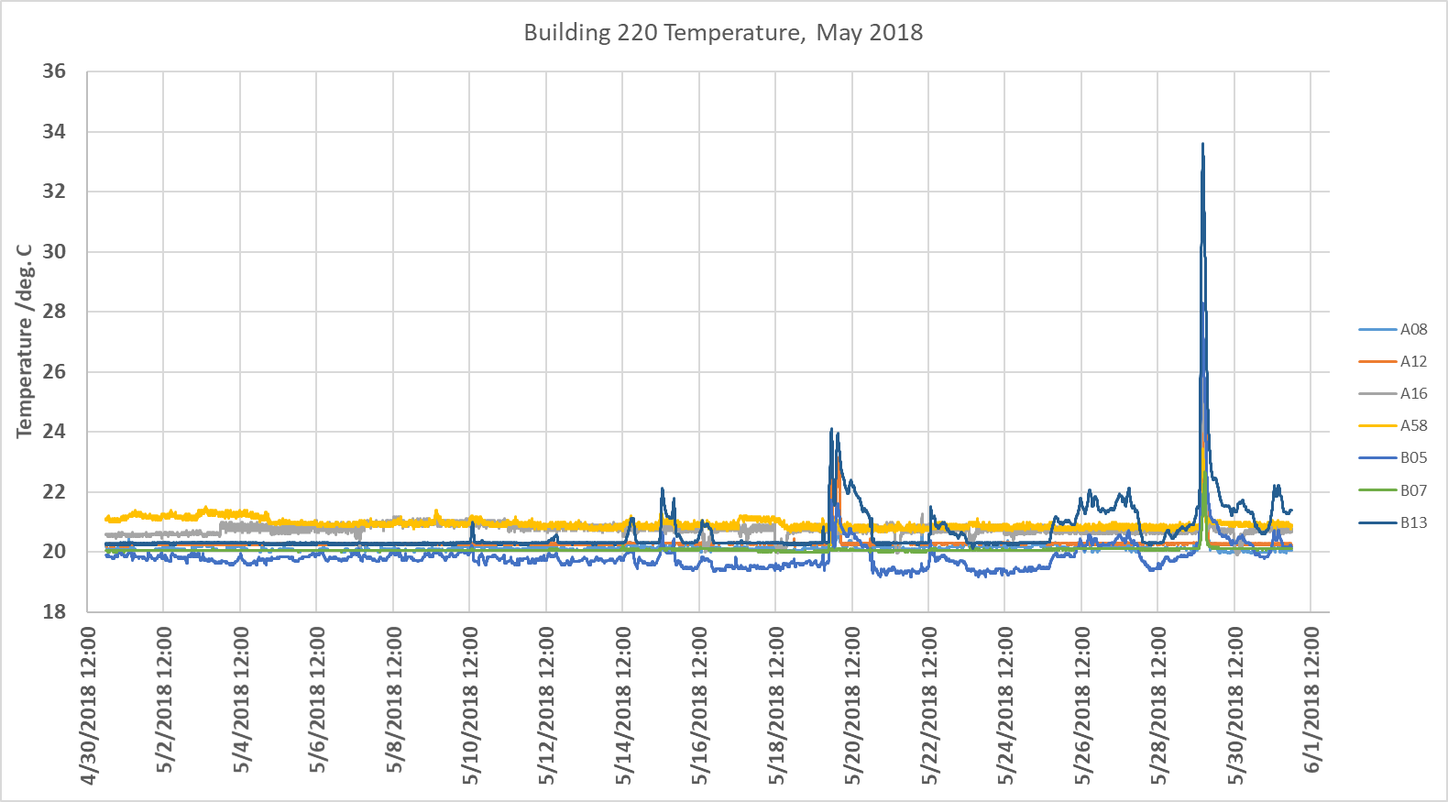
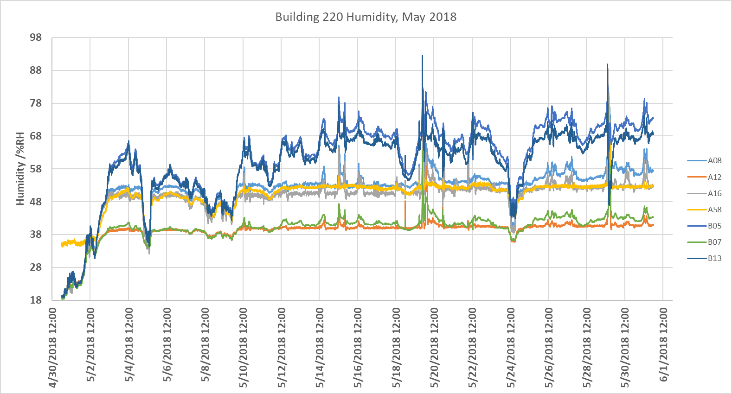
Example Data
Notes:
These graphs are from May of this year in two of our buildings. The top row is the AML building, bottom row is our 50-year old Metrology building. Left column is temperature, right column is humidity. Each line is the environment of a single lab. Unfortunately for our workload, but fortunately for gathering data, this year has been a very active year. In Gaithersburg, MD there were several severe storms in the last few months and a very intense windstorm in February that each time knocked out a portion of the NIST site. For example, in May 2018 there were storms caused power loss to a portion of the site, twice in that month, resulted in failure of HVAC equipment. The red arrows indicate the environment outage in both buildings simultaneously during each storm. Our group is certain we knew about the outages before even the HVAC guys because this system will also turn itself back on in the case of a power outage, once it receives power again, and resumes sending messages. It sent message to everyone on each lab mailing list. There were a total of 93 messages sent per outage, or an average of 3 per lab in the Dimensional Metrology Group. These events are an act of fate and cannot be timely resolved, but what can be resolved quickly are control board failures, HVAC motor belt failures, anything that can occur when you are not actively watching the environment. This system watches it constantly and tells you when something undesirable has happened.
For example, earlier in May 2018 the control board of our gage lab, this green line, failed on a Saturday, May 5th. We knew something had gone wrong, diagnosed the issue, and had the control board replaced by the following Monday. As a result of installing the system, we have also learned that our humidity controls in the AML building are not as good as we had thought. You can see by the high activity in the top right data, ignoring immediately after the storms.

Slide 18
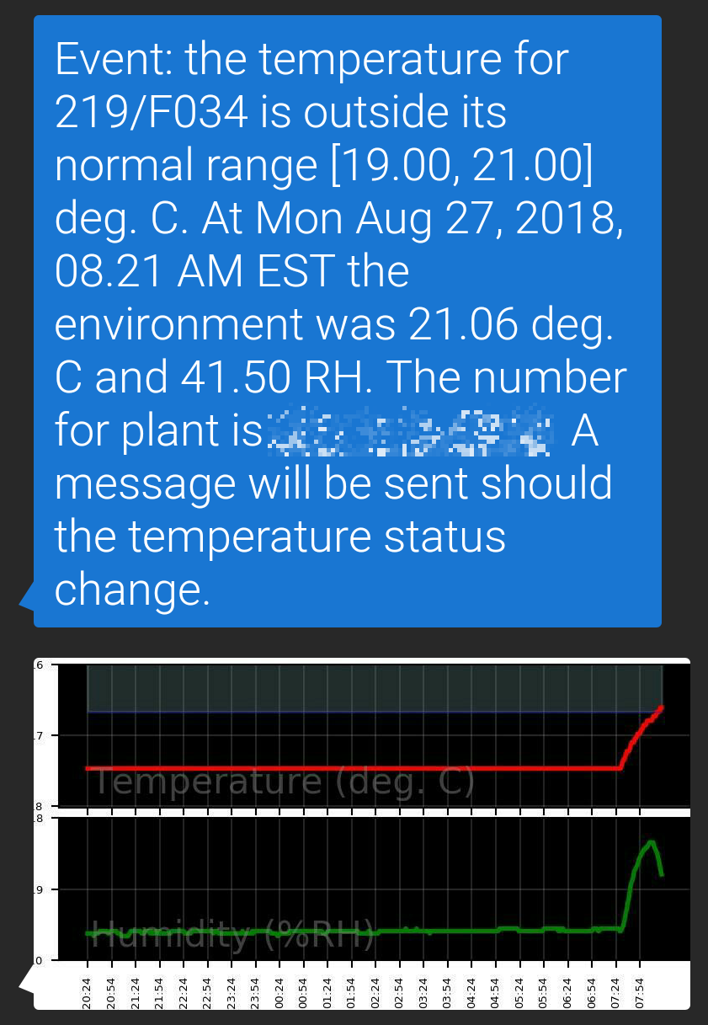
Example Data
www.nist.gov/pml/engineering-physics-division/dimensional-metrology
Dimensional Metrology Group
Engineering Physics Division
Physical Measurement Laboratory
Notes:
Here is an example of what the messages look like when sent by text message on my phone. It gives a description of the current environment at the time of the event and notifies you in a separate message when conditions return. If you’re observant, this message was sent on Monday morning for our long block lab. If you have long blocks being calibrated by us, well, they may be delayed because of the high temperature. I do think it has since returned Monday afternoon or evening.

Slide 19
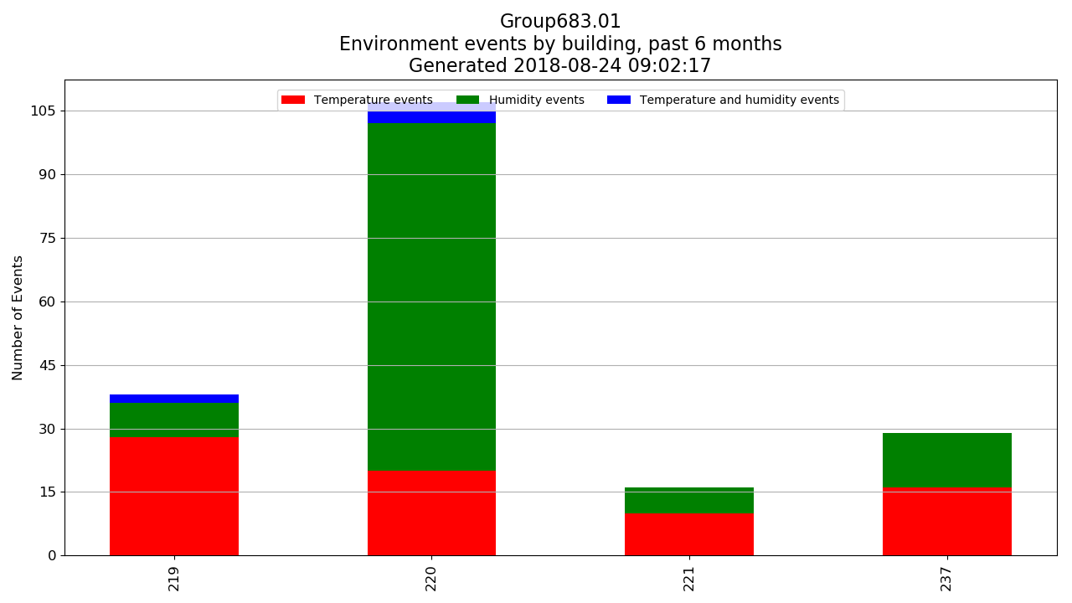
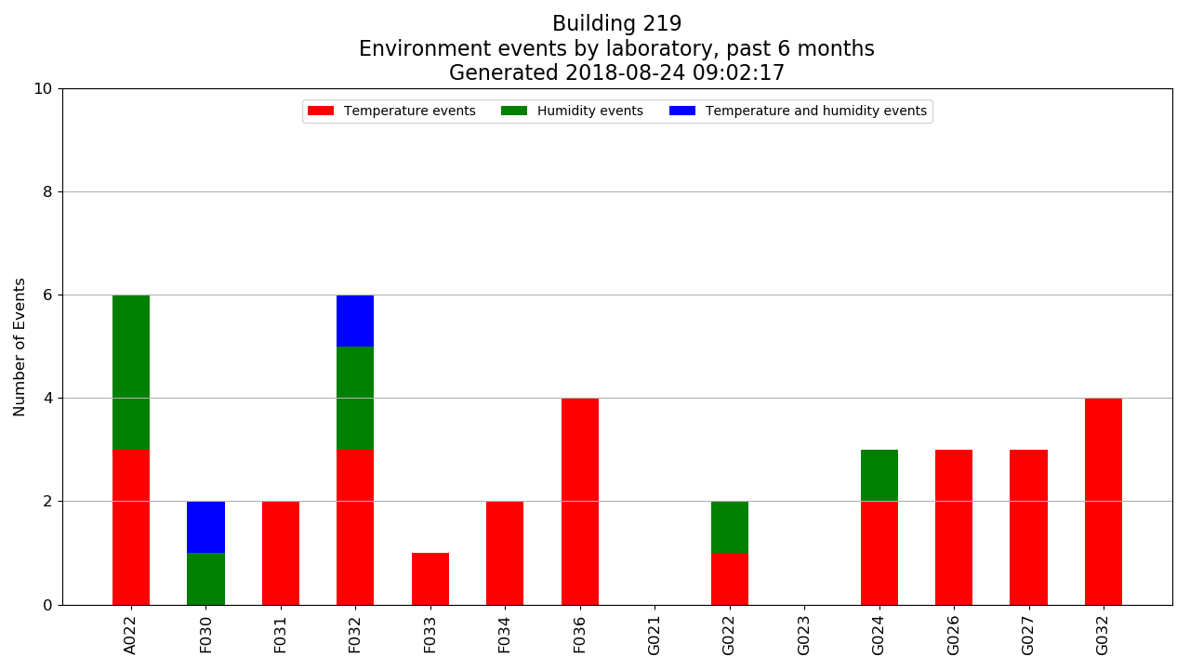
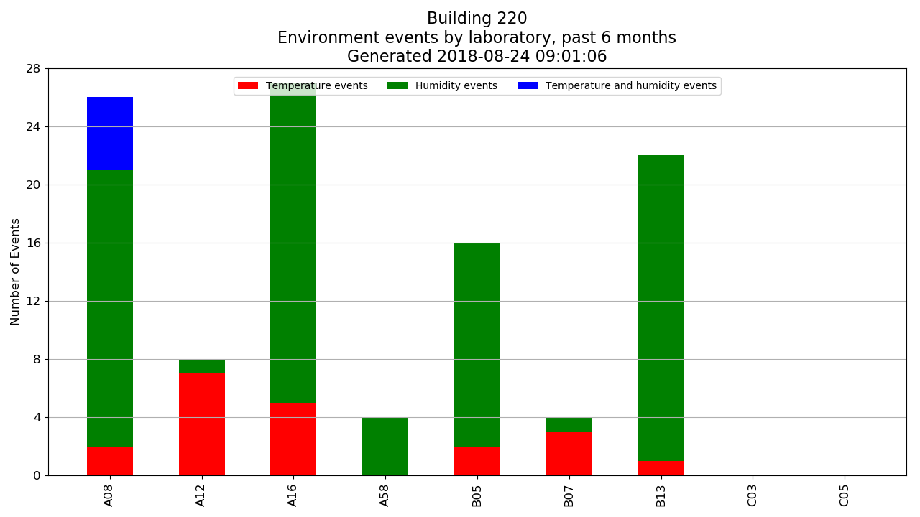
Example Data
www.nist.gov/pml/engineering-physics-division/dimensional-metrology
Dimensional Metrology Group
Engineering Physics Division
Physical Measurement Laboratory
Notes:
Something else we can do with the data is examine how often our environments exit desirable conditions within our group. The top chart is the number of outages within our group per building for the past 6 months. The different colors on the stacked bar charts represent the type of event, humidity, temperature, or both. We can then break down the data further to examine, within each building, what has happened in each lab, and determine how reliable each lab is according to our defined environment conditions, even determine a percentage uptime if desired.

Slide 20
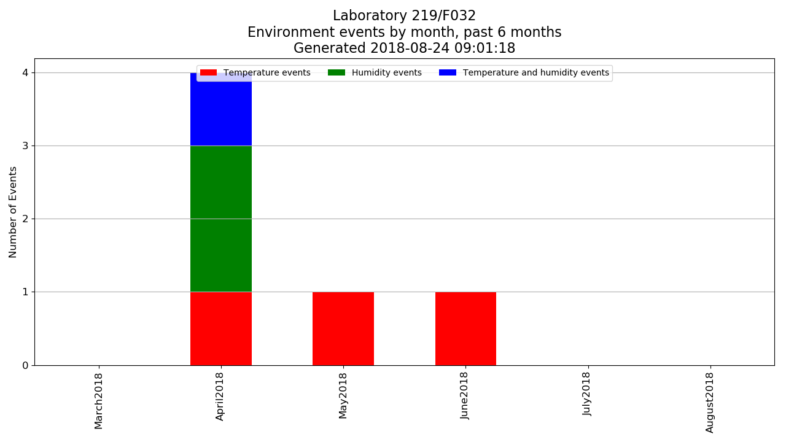
Example Data
www.nist.gov/pml/engineering-physics-division/dimensional-metrology
Dimensional Metrology Group
Engineering Physics Division
Physical Measurement Laboratory
Notes:
And from that data, we can examine when an individual lab has had the most activity. I randomly picked one lab to show you, in this case the optical fiber comb lab. In April there was a fair amount of activity here, but it seems to be improving, possibly as a result of feedback from the system

Slide 21
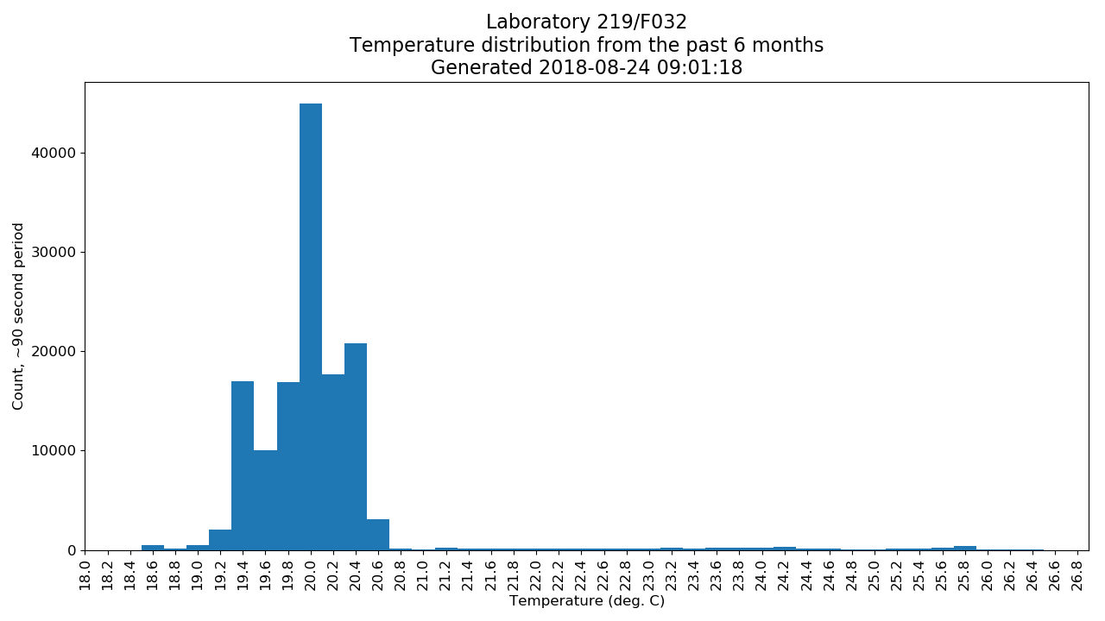
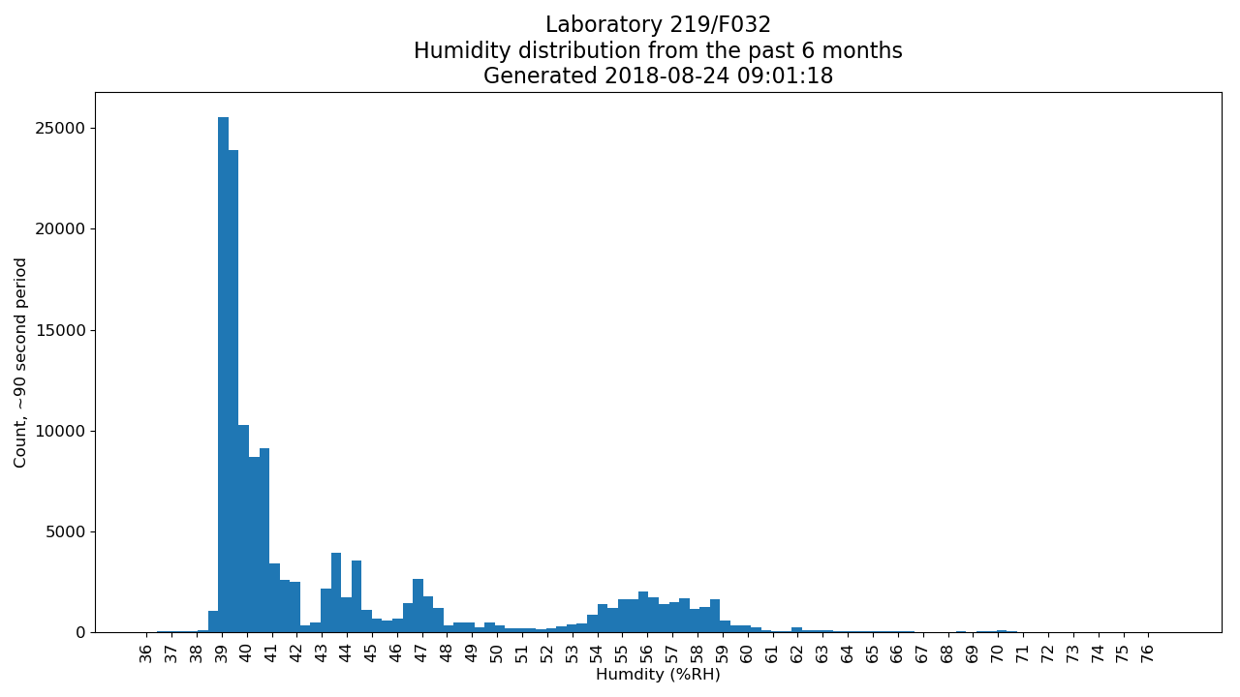
Example Data
www.nist.gov/pml/engineering-physics-division/dimensional-metrology
Dimensional Metrology Group
Engineering Physics Division
Physical Measurement Laboratory
Notes:
Finally, we can examine how the environment of a particular lab is distributed over some period. These graphs were all generated by our master system which hosts the website. The master system’s only purpose is to collect data from each device, process it according to how we want to view our data, and publish these past graphs every 5 minutes for each lab. The master system makes no decisions, only provides information.

Slide 22
Overview
Purpose?
ISO 17025
Temperature and humidity in Dimensional Metrology
Design and cost
Example data
Lab environment incidents
Monitoring website
Link to Github download
www.nist.gov/pml/engineering-physics-division/dimensional-metrology
Dimensional Metrology Group
Engineering Physics Division
Physical Measurement Laboratory
Notes:
The last thing I would like to do is share the code of the environment monitoring system in the form of a github link.

Slide 23
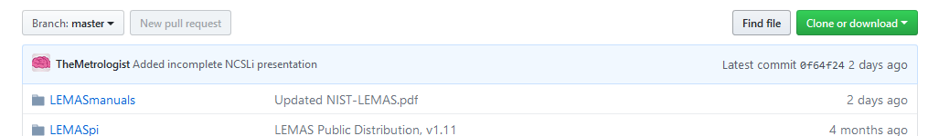
Freely available!
Download for NIST-developed environment monitoring:
LEMAS https://github.com/usnistgov/LEMASdistPub
Example master setup https://github.com/usnistgov/LEMASmaster
Contains:
Python 3 logging program, configurable alerts by email and text (MMS and SMS)
3D-printable model (.stl format) to mount 5 inch 800x480 display and Raspberry Pi 3
Instructions to install LEMAS onto Raspbian OS
Some configuration required (how-to is in instructions to install. Pdf or README)
Need to build interface for your sensor
www.nist.gov/pml/engineering-physics-division/dimensional-metrology
Dimensional Metrology Group
Engineering Physics Division
Physical Measurement Laboratory
Notes:
This is where you can download the software to run your own logging and alert system. USNISTGOV is the official NIST github repository. The download contains: Python program to log data and send alert messages, a 3D-printable model to mount a raspberry pi 3 with a 5 inch 800x480 display, and instructions on how to install the software onto the primary raspberry pi operating system, Raspbian. I would rather have posted an image of Raspbian with the system installed so you can simply flash it onto a microSD card, but github has filesize limitations, 2 GB or so. It is entirely open source, you can peek through the code to ensure it isn’t doing anything malicious or collecting data to send to me. Though, if you do use the system send me an email so I can let you know whenever an update is available…I haven’t figured out self-updating yet. Ask me if you would like to make modifications or improvements, I would be more than happy to add you as a contributor to the github repository. With this platform and Python setup, we or even you, could expand the system to do anything in the lab provided there is a means to capture the relevant data.
If you have never used github, like me prior to pushing this to github in May or so, you can download the package by clicking the green button in the top right that says clone or download, then click download ZIP. Unpack the ZIP and all the files are inside, including the 3D printable model in one of the folders. Alternatively, you can use the git command from a linux terminal to download the package directly from github.

Slide 24
Freely available!
Download for NIST-developed environment monitoring:
LEMAS https://github.com/usnistgov/LEMASdistPub
Example master setup https://github.com/usnistgov/LEMASmaster
Thank you for your time!
Questions?
Michael Braine: michael.braine@nist.gov
(rarely near my phone, use email)
www.nist.gov/pml/engineering-physics-division/dimensional-metrology
Dimensional Metrology Group
Engineering Physics Division
Physical Measurement Laboratory
Notes:
Something that I would like to see come out of this is a modular smart-laboratory system, because devices these days are “smart devices” – smart cars, smart homes with smart thermostats connected to smart phones. It makes sense to have a smart lab, right?
That is all I have to share, and I would like to thank you very much for your time. If you give this a download and have problems setting it up on a Raspberry Pi, send me an email and if you’re nice I will be happy to help you out. Any questions?

